Slide 1
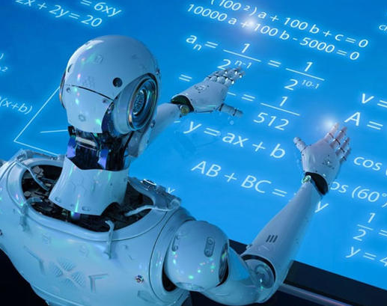
Artificial Intelligence and Machine Learning
Mohamed K. Hussein
Computer Science Department,
Faculty of Computers & Information Science,
Suez Canal University

Slide 2

Talk outcomes
Defining Artificial Intelligence
Demand for Artificial Intelligence
Artificial Intelligence Applications
Artificial Intelligence vs Machine Learning
Introducing Types of Machine Learning
Supervised Learning
Unsupervised Learning
Reinforcement Learning
Deep Learning

Slide 3

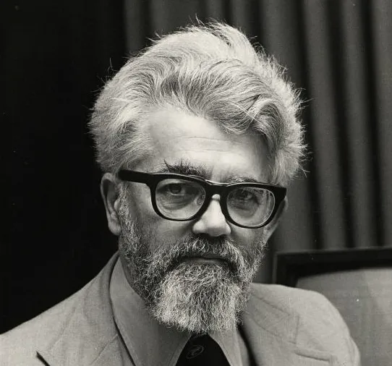
What is Artificial Intelligence?
John McCarthy defined Artificial Intelligence (AI) as “The science and engineering of making intelligent machines” in 1956.

Slide 4
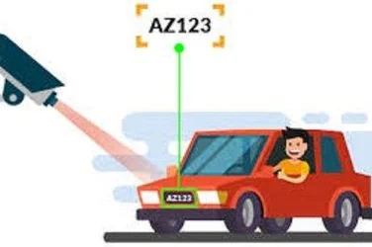
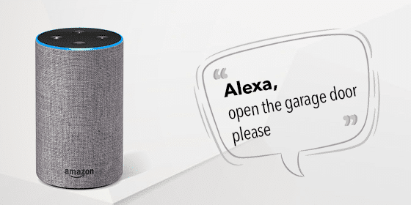
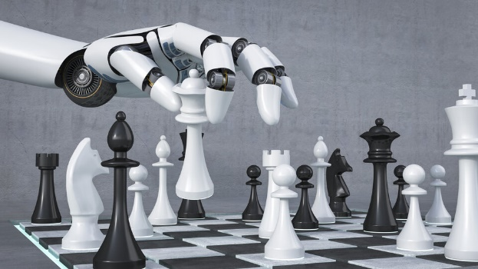
AI
AI is the theory and development of computer systems able to perform tasks that normally require human intelligence, such as visual perception, speech recognition, decision-making, and translation between languages.
The art of making machines work and behave like human.

Slide 5
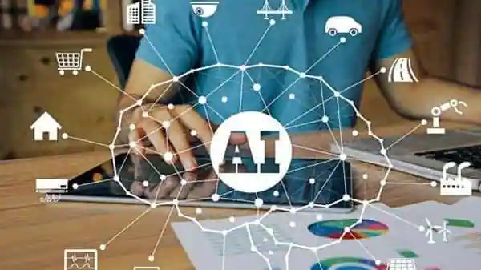
Demand for AI
Computational power
Better algorithm
Huge data

Slide 6
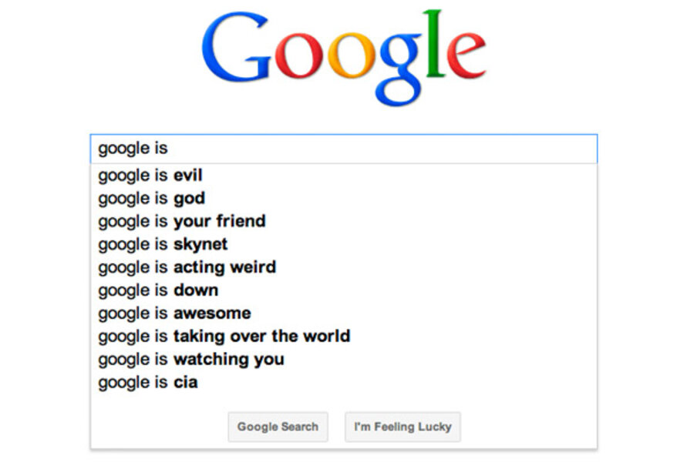
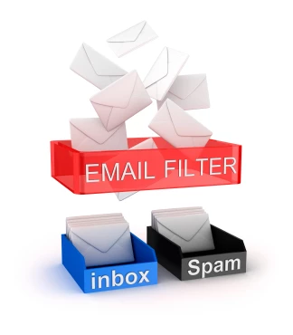
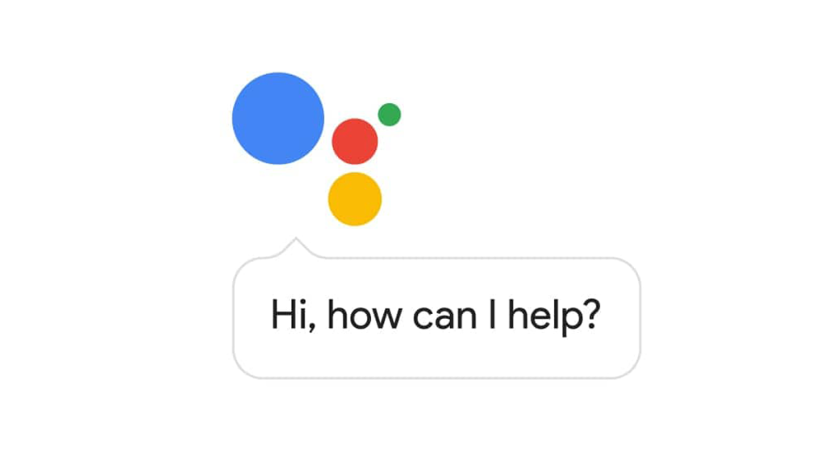
AI Applications
Google predictive search engine
Google duplex
Spam filters

Slide 7

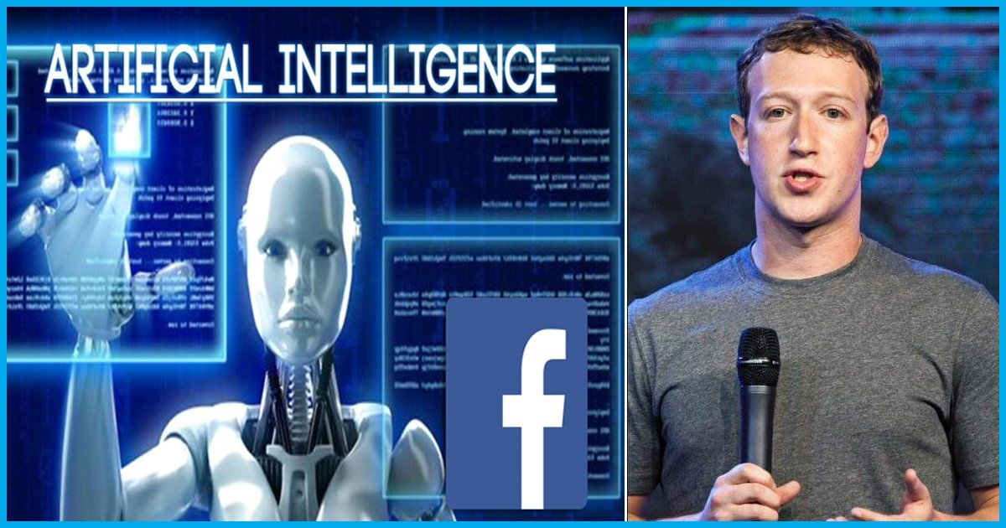
AI Applications
Detect facial features and friends tagging.

Slide 8


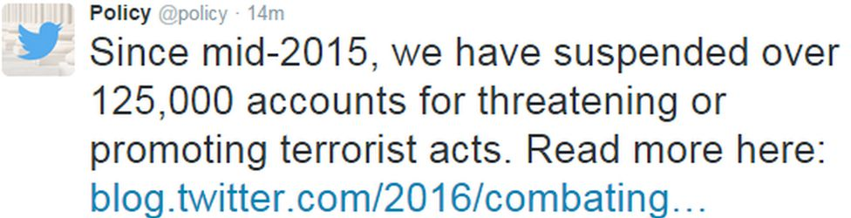
AI Applications
Identify hate speech and terroristic language.

Slide 9
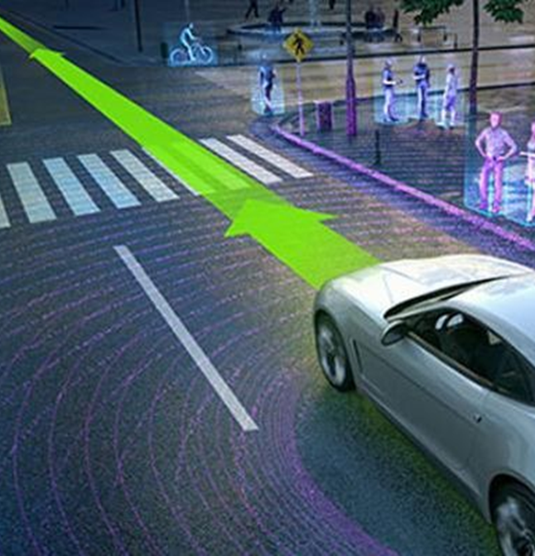
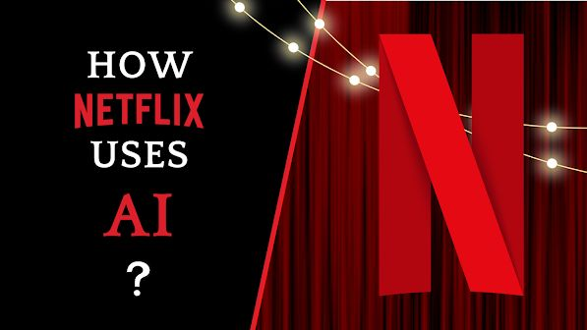
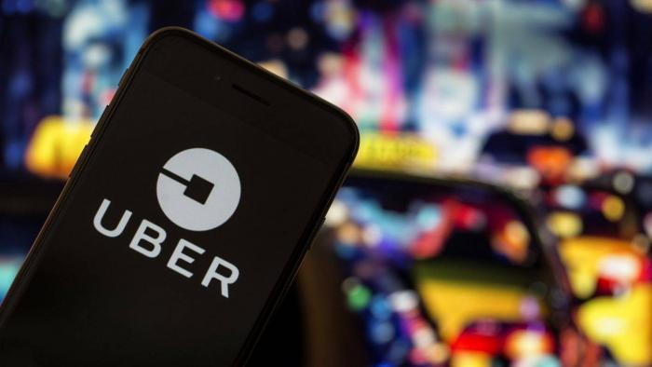
AI Applications
Tesla self driving cars.
Netflix
Uber - Differential pricing in real-time

Slide 10
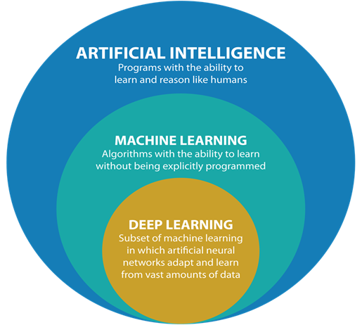
AI vs Machine Learning
AI is intelligent machines that think and act like human beings.
Concepts of AI:
Natural language processing
Machine learning
Knowledge representation
Automated reasoning
Computer vision
Robotics

Slide 11
AI vs Machine Learning

Slide 12
AI vs Machine Learning

Slide 13
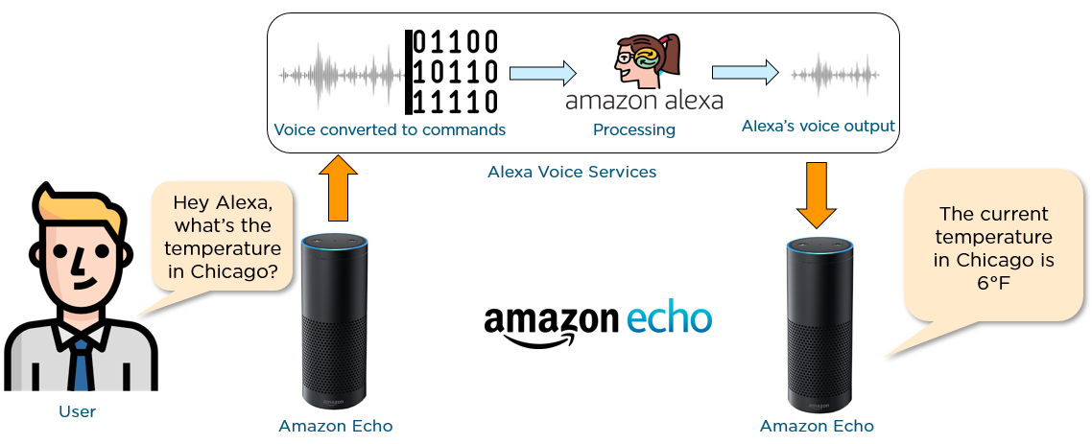
AI vs Machine Learning

Slide 14
AI vs Machine Learning
Machine learning (ML) is algorithms that can improve their perception, knowledge, thinking, or actions based on experience or data.

Slide 15
Types of Machine Learning
ML
Supervised
Unsupervised
Neural Networks & Deep Learning
Reinforcement Learning
Predict the future based on past data.
Must provide labeled data to train the model.
The model is able to identify hidden patterns from the training data.
No training data.
The model learns on the basis of the reward/punishment received from the last action.
The model is based on the simulation of the neurons in human brains

Slide 16
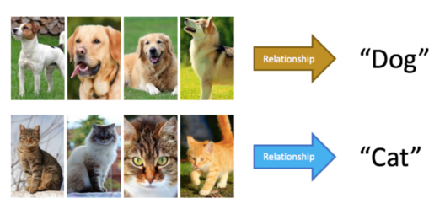
Supervised Learning
In supervised learning, a computer learns to predict human-given labels, such as dog dog-cat identification based on labeled dataset.
The most widely used supervised learning approaches:
Linear Regression
Logistic Regression
Decision Trees
Random Forest
Support Vector Machines
K-Nearest Neighbors

Slide 17
Applications of Supervised Learning
Text categorization
Face Detection
Signature recognition
Customer discovery
Spam detection
Weather forecasting
Predicting housing prices based on the prevailing market price
Stock price predictions

Slide 18
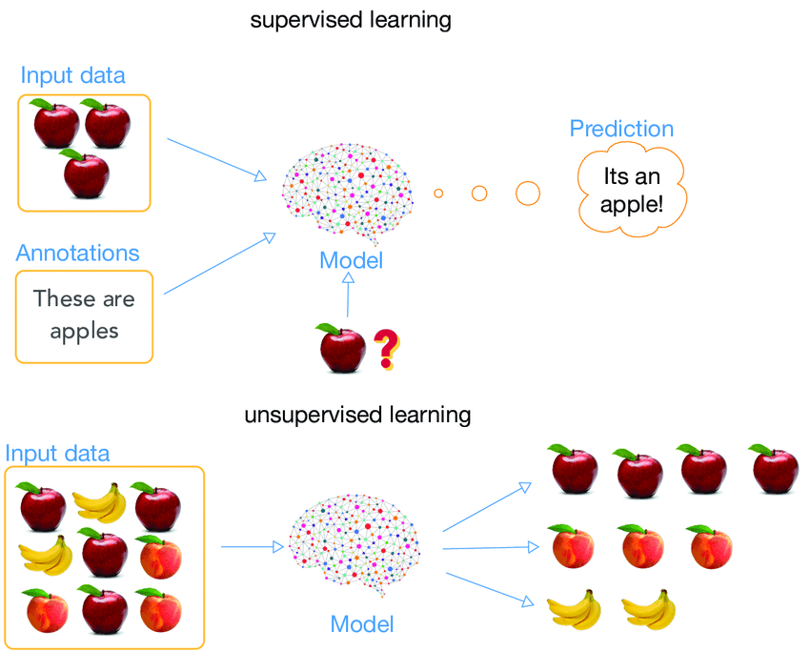
Unsupervised Learning
Unsupervised learning does not require labels.
The most widely used supervised learning approaches:
k-means clustering
PCA (Principal Component Analysis)
Association Rule

Slide 19
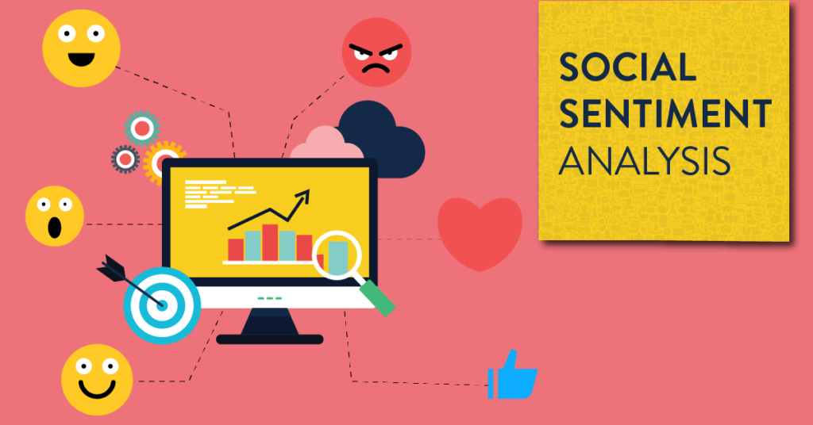
Applications of Unsupervised Learning
Social sentiment analysis
Fraud detection
Malware detection
Identification of human errors during data entry

Slide 20
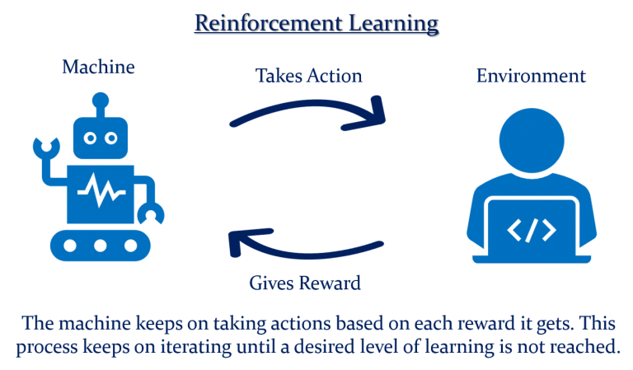
Reinforcement Learning
The most widely used RL learning approaches:
Q-Learning
Temporal Difference (TD)
Monte-Carlo Tree Search (MCTS)
Asynchronous Actor-Critic Agents (A3C)

Slide 21
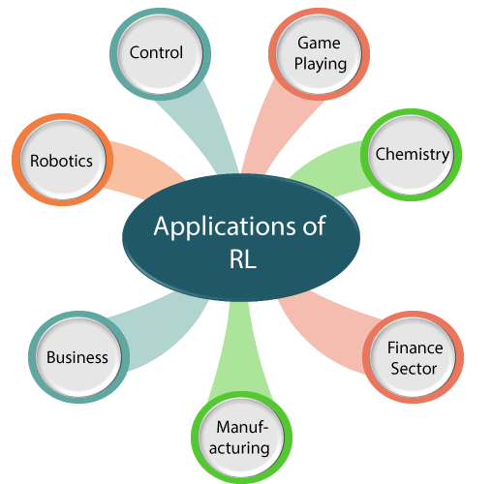
Applications of Reinforcement Learning
In marketing, predicting the choices, reactions, and behavior of customers towards your products/services to increase profit margins.
In chemistry, optimizing the chemical reactions.
In automobile manufacturing companies, the robots use reinforcement learning to pick goods and put them in some containers.
In the finance sector, evaluating trading strategies.

Slide 22
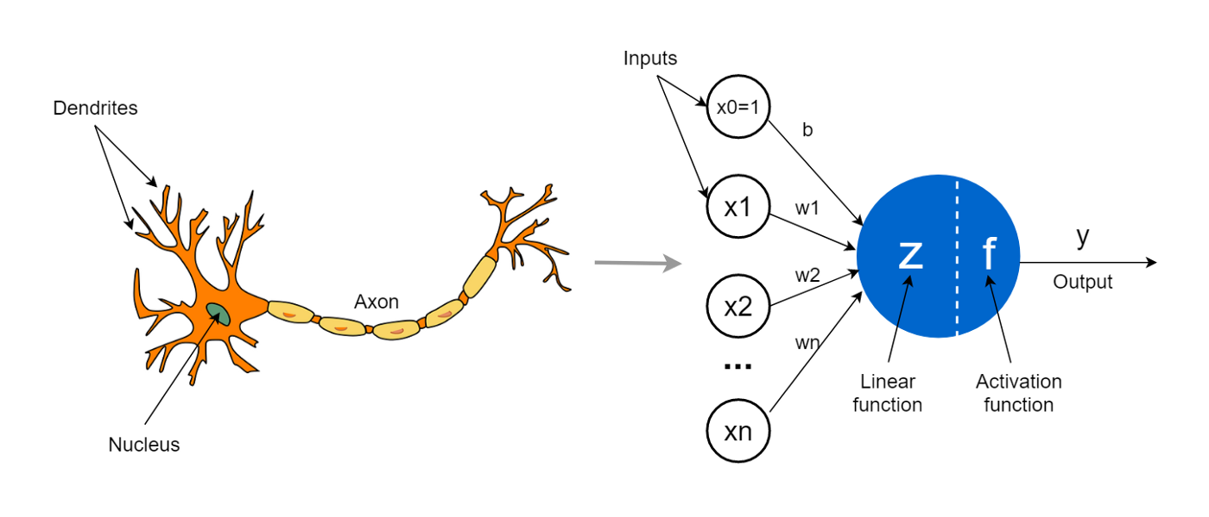
Neural networks & Deep Learning
Deep Learning is an approach of machine learning that uses a computing model inspired by the structure of the human brain.

Slide 23
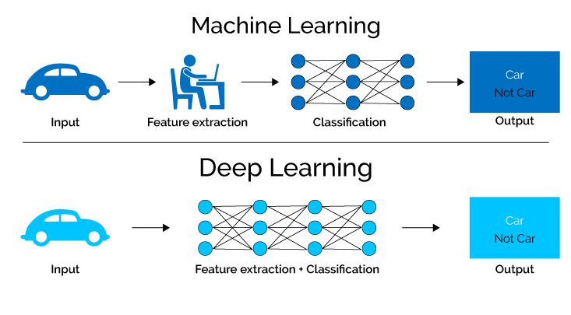
Deep Learning
Deep Learning is statistical machine learning technique used to learn features hierarchies based on the use of large multi-layer (artificial) neural networks.
Deep learning algorithms:
Convolutional Neural Networks (CNNs)
Long Short Term Memory Networks (LSTMs)
Recurrent Neural Networks (RNNs)
Generative Adversarial Networks (GANs)
Radial Basis Function Networks (RBFNs)
Multilayer Perceptrons (MLPs)
Self Organizing Maps (SOMs)
Deep Belief Networks (DBNs)

Slide 24
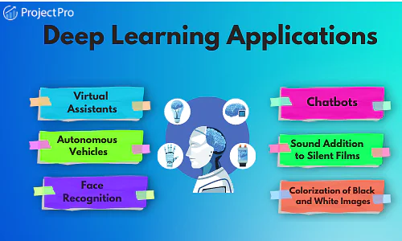
Applications of Deep Learning
Self-driving cars
Voice Search & Voice-Activated Assistants
Automatic Machine Translation
Image Recognition
Energy Market Price Forecasting

Slide 25
Thank you

